Slide 1
Welcome to Grooming session for Graduates
IsDB-BISEW
IT SCHOLARSHIP PROGRAM

Slide 2
Tips to a Successful Interview continuing
Know the exact time and location of your interview;
know how long it takes to get there;

Slide 3
Tips to a Successful Interview
Be punctual. Arrive at least 30 minutes prior to scheduled time
Politely introduce yourself
If you have to wait, read as much as you can about the company & sample question

Slide 4
Tips to a Successful Interview continuing
Be a good listener
Look confident. Body interest-can show your interest.
Be prepared for an Interview
Make sure that your project is ready

Slide 5
Tips to a Successful Interview continuing
Bring a hard copy CV with photograph
Use reference in your CV and inform referee
Project hard copy and photocopy of certificates are readily available

Slide 6
About Cell phone
Cell phone must be silent during interview
Your phone must be activated and
Call back for miss call

Slide 7
First Impressions
Be clean and neat, including your fingernails, teeth, shoes, hair and face
Use good eye contact
Don't interrupt and don't argue!
Use good manners and this is important
Wear formal dress (white/light color shirt & black color pant, black shoes) avoid jeans or other casual clothing

Slide 8
General Question for Interview
Tell us something about yourself;
What is your expected salary?
Why do you want to work here?
What are your strength & weaknesses?
Where do you see yourself in five years’ time?
Why should we hire you?
What do you know about this organization?
Note: Try to collect more sample question from placed graduates, Instructor and course consultant
Possible Answers

Slide 9
Salary?
Salary as per the organization salary structure;
Do not think about salary first, think about your task;
Initial salary structure may be lower than expectation.
Salary will be increased gradually;
Don’t expect high salary as a fresher;

Slide 10
Important Advices
Some organization have specific salary structure;
Do not think about salary first, think about your task;
Initial salary structure may be lower than expectation;
Salary will be increased gradually;
Don’t expect high salary as a fresher;

Slide 11
List of Jobs Sites
http://www.bdjobs.com/
http://www.jobsa1.com/
http://www.prothom-alojobs.com/
http://www.chakrimela.com
http://chakri.com
https://bikroy.com/en/ads/bangladesh/jobs
http://www.job.com.bd/
www.bdnews24.com/classifieds/jobs
www.uncareer.net/country/Bangladesh
https://www.careerjet.com.bd/

Slide 12
List of important Study site
http://www.indiabix.com/ (IQ test question and logical questions)

Slide 13
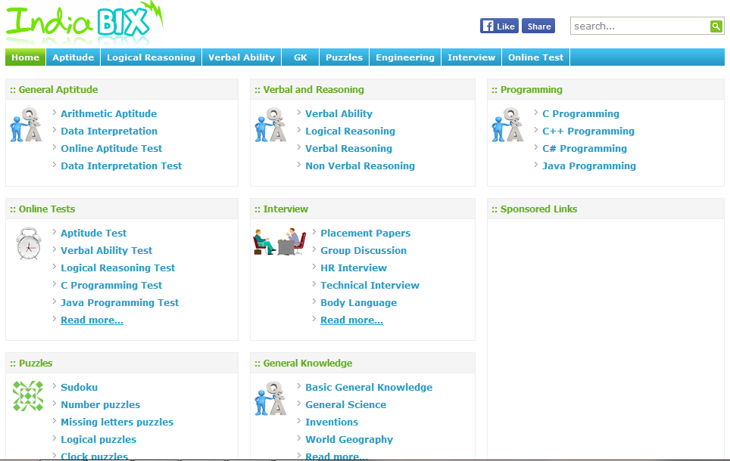

Slide 14
Update your CV in the CareerHub
You have to update following information of your CV in the Career Hub:
Current Address, Phone, Email
Project Information
Strength
Project Title
Tools and Technologies used
Project duration
Portfolio / Project links ( If your project is online)
Academic Information (If applicable)
References
Note: If you mention references to your CV then you have to notify your referee. Incomplete CV will not be provided to the employer.

Slide 15
CV updating process in CareerHub
If you face any problem during updating your CV, Please Contact with CareerHub Admin at Show & Tell.
Mr. Asif - 01711- 196635

Slide 16
Appointment Letter/Placement Confirmation document Send to: Mr. Md. Helalur Rahman Program Officer (Placement) Mobile : 01670-462007 Email Address: helal@idb-bisew.org

Slide 17
Appointment Letter/Placement Confirmation document Send to: Mr. Md. Shariful Islam Placement Officer Mobile : 01552-450991 Email Address: sharif@idb-bisew.org

Slide 18
Important Advices (Cont.)
Send an email / SMS of your interview information to Placement Cell (Interview date, Trainee ID, organization name) for tracking;
Inform placement executive about your written exam date, organization name and Trainee ID;
If you are placed then immediately inform Placement Cell;
Send your appointment letter hard copy or send scan copy after getting job to the Placement Cell.

Slide 19
Send an email/SMS of your interview information to Placement Executive (Your Interview date, Trainee id, Name, Mobile Number & organization name) for tracking
If you are placed then you have to inform us.
Mr. Helalur Rahman
Program Officer(Placement)
01670-462007
Mr. Shariful Islam
Placement Officer
01552-450991
Bring your appointment letter or send scan copy though email after getting job to; helal@idb-bisew.org

Slide 20
GOOD LUCK

